Slide 1

Comparative Analysis of Deep Convolutional Neural Networks for Pneumonia Detection in Chest X-ray Images
Group D3
Akhilesh P– BL.EN.U4AIE21006
Amal Krishna – BL.EN.U4AIE21008
D Subham– BL.EN.U4AIE21046
Karthick Bharadwaj- BL.EN.U$AIE21112
Project presentation
21AIE312-Deep Learning for Signal & Image Processing

Slide 2
Contents
Introduction
Problem Statement
Dataset Description
Proposed Methodology
Architecture
Training config and eval metrics
Custom layers
Results
Conclusion

Slide 3
Introduction
Pneumonia is an infection that inflames the air sacs in one or both lungs.
Causes include bacteria, viruses, and fungi.
It is a significant health issue, especially in children and the elderly.
Early and accurate detection is crucial for effective treatment.
Historically, pneumonia diagnosis relied on physical examination, medical history, and chest X-ray interpretation by radiologists.
Deep learning methods offer the potential for faster and more consistent diagnosis, but they also require large datasets and careful validation to ensure accuracy.

Slide 4
Problem Statement
Binary Classification of chest radiograph images
Deep learning methods, particularly deep convolutional neural networks, have emerged as powerful tools for automating pneumonia diagnosis from chest X-ray images.
Develop a system to detect pneumonia from chest X-ray images.
Train and evaluate multiple deep learning models.
Customize models to improve their performance for this specific task.
Compare the effectiveness of RESNET50, VGG16, INCEPTION V3, DENSENET201, Xception.

Slide 5
Dataset Description
https://www.kaggle.com/datasets/paultimothymooney/chest-xray-pneumonia
5863 jpg images
2 categories (Pneumonia/Normal)
Chest X-ray images (anterior-posterior) were selected from retrospective cohorts of pediatric patients of one to five years old from Guangzhou Women and Children’s Medical Center, Guangzhou.
All images initially screened for quality control by removing all low quality or unreadable scans
The diagnoses for the images were then graded by two expert physicians before being cleared for training AI models.

Slide 6
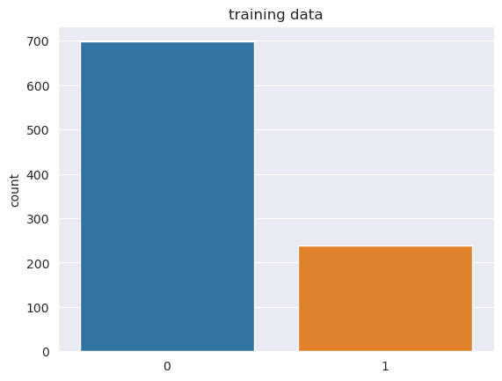
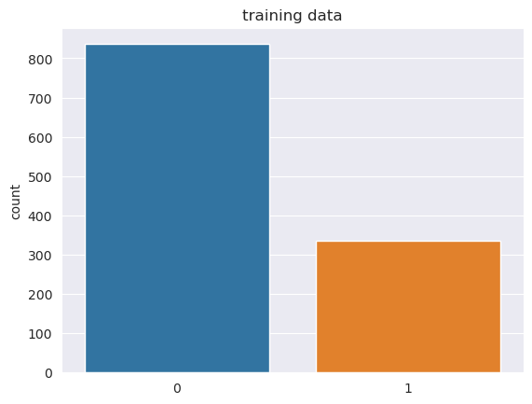
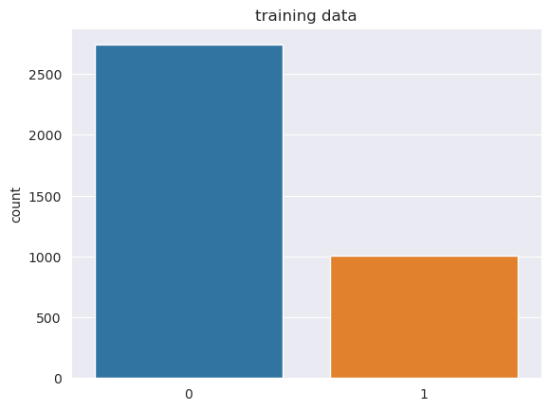
Methodology
Data Pre Processing
Images resized to 224x224
Split into train, test and val
Separate images and labels
Normalize data
Data augmentation (random rotations, zoom, shift and flips)
Define early stopping and learning rate reductions

Slide 7
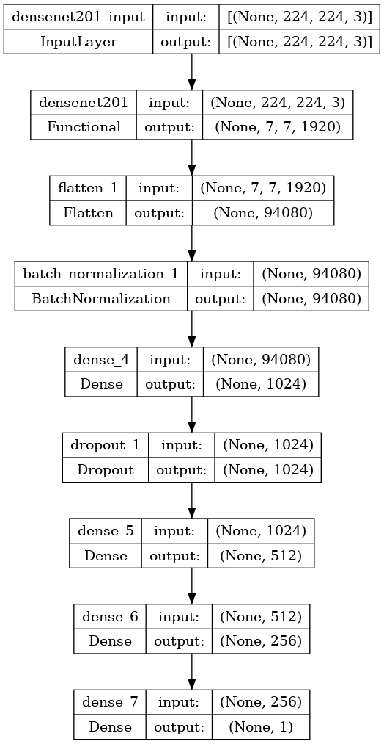
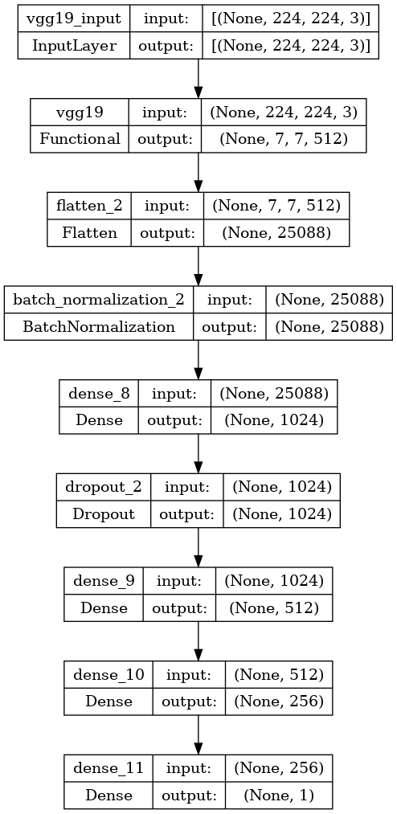
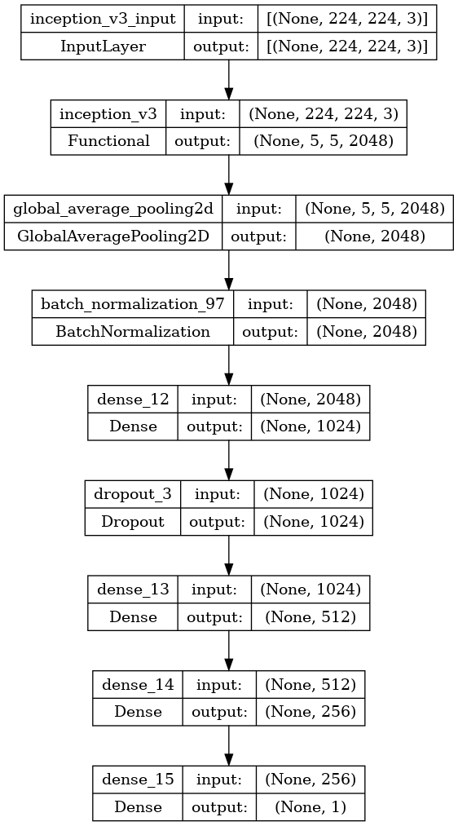
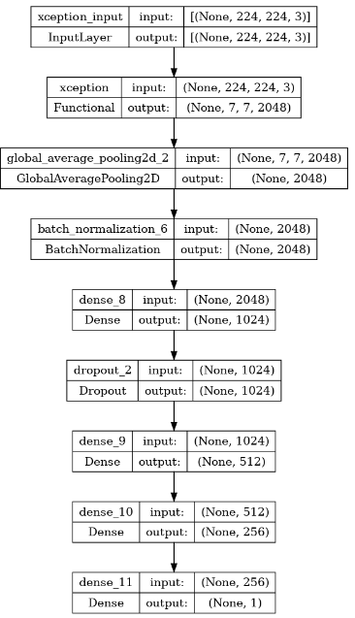
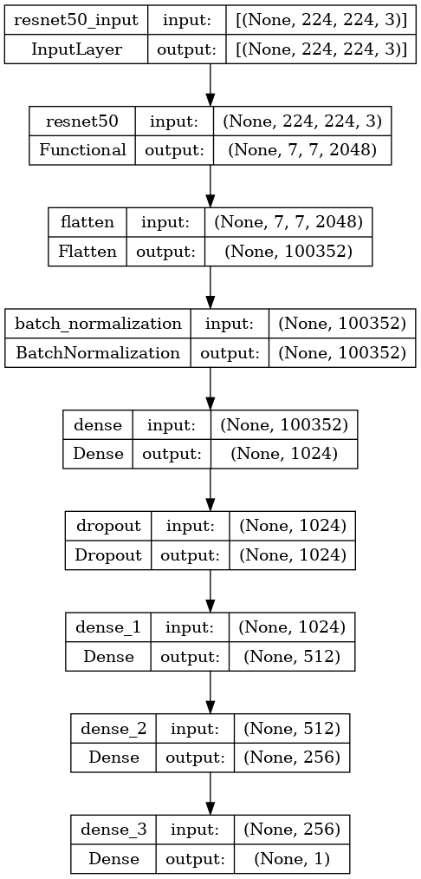
Model Architectures

Slide 8
Training Config & Evaluation metrics
Learning Rate: default for Adam optimizer 0.001.
Batch Size: 32
Epochs: 50
Optimizer: Adam optimizer for adaptive learning.
Loss Function: Binary cross-entropy.
Accuracy: Overall correctness of the model.
Precision: Correct positive predictions out of total positive predictions.
Recall: Correct positive predictions out of actual positives.
F1 Score: Harmonic mean of precision and recall.
AUC-ROC: Area under the ROC curve, measures the ability to distinguish between classes.

Slide 9
Custom Layers
Global Average Pooling:
Reduces dimensions, prevents overfitting.
Flatten Layer: Converts 2D matrix data to a 1D vector.
Essential for transitioning from convolutional layers to fully connected layers.
Dense Layers:
Fully connected layers with 1024, 512 and 256 neurons.
Activation function: ReLU.
Dropout Layers:
Dropout rate of 0.5 to prevent overfitting.
Output Layer:
Sigmoid activation for binary classification (Pneumonia or Normal).

Slide 10
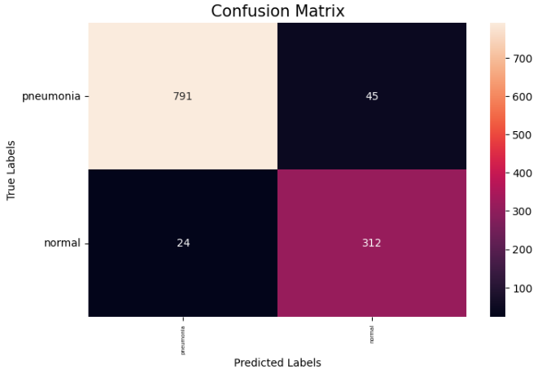
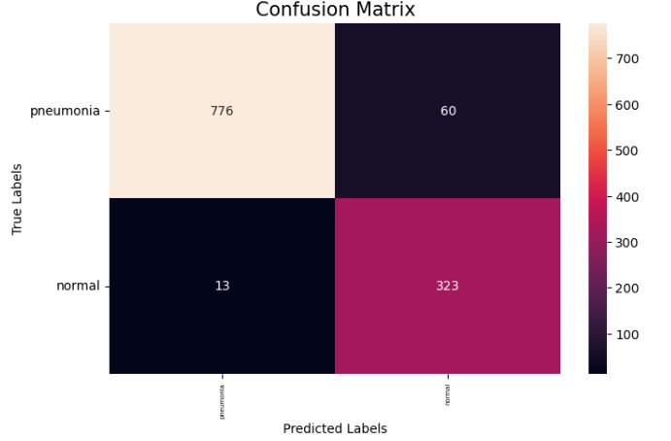
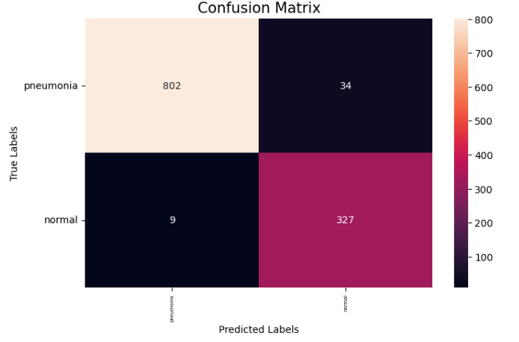
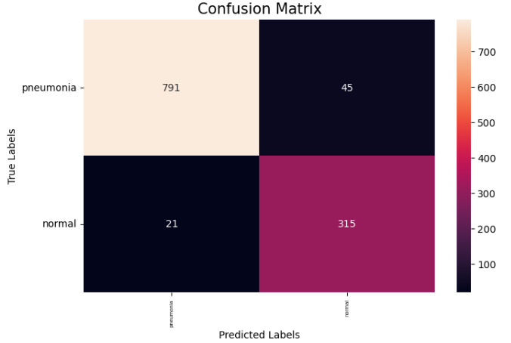
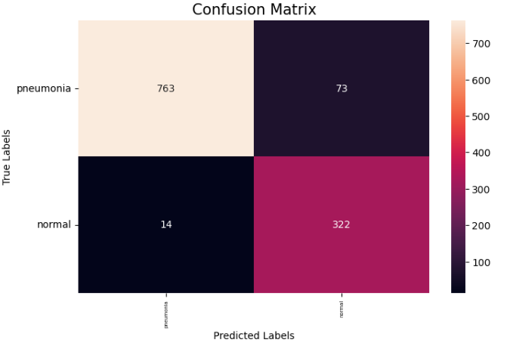
Results
Inception v3
VGG 19
Densenet 201
Resnet 50
Xception

Slide 11
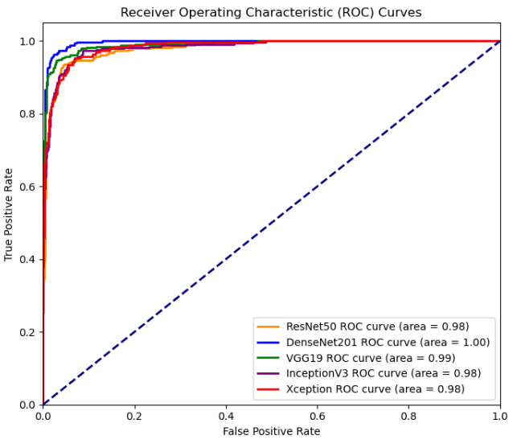
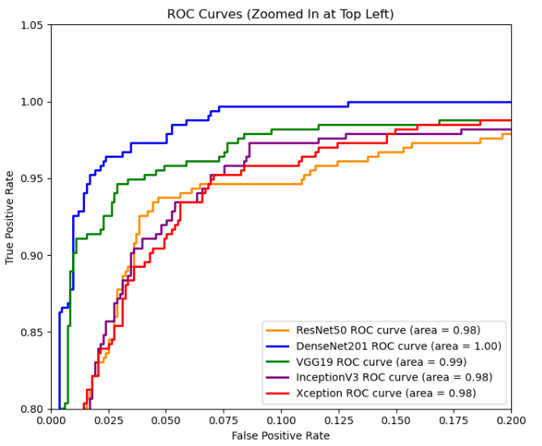
Results
Model/Metric | Accuracy | Precision | Recall | F1 Score | Specificity
RESNET50 | 93.088737 | 83.819629 | 94.047619 | 88.639551 | 92.703349
VGG19 | 94.027304 | 84.635417 | 96.726190 | 90.277778 | 92.942584
INCEPTION V3 | 94.795222 | 87.878788 | 94.940476 | 91.273247 | 94.736842
DENSENET201 | 96.331058 | 89.276139 | 99.107143 | 93.935120 | 95.215311
XCEPTION | 92.576792 | 81.518987 | 95.833333 | 88.098495 | 91.267943

Slide 12
Conclusion & Future Scope
All models successfully detected pneumonia with varying accuracy.
Densenet201 showed the highest accuracy and generalization.
Potential for implementation in clinical settings.
Could assist radiologists in early pneumonia detection.
Further tuning of hyperparameters.
Exploring more advanced architectures.

